Slide 1
RESEARCH SPHERE AI,
AI-Powered Research Matching Agent
A LangGraph-powered, multi-agent terminal system connecting students and
professors to the right people, projects, and research directions.
NATIONAL-LEVEL AI HACKATHON — FINAL PRESENTATION

Slide 2
WHY RESEARCH SPHERE AI
The Problem
S
Students
P
Professors
No structured way to discover faculty matching their interests
Faculty availability is invisible until they reach out
Projects found via word-of-mouth, not real expertise match
No visibility into current research trends
Tracking fast-moving research trends is entirely manual
Finding the right in-department collaborator is informal
No systematic view of missing research domains
Outreach to students/collaborators is untracked
ResearchCompass
Problem Statement
2

Slide 3
WHAT WE BUILT
Solution Overview
ResearchSphere AI is a terminal-based, LangGraph-powered multi-agent assistant. A natural-language question is routed to the right specialist agent, grounded in a real faculty knowledge base.
Two Modes, One Agent
S
F
Student
Faculty Match
→
Who uses it
Students in discovery mode, professors in research-intelligence mode
ResearchSphere AI
→
How it works
Router classifies intent → agent pipeline runs → human confirms outgoing email
P
I
→
Objective
Professor
Insights
Faster student-faculty matching and live trend/gap intelligence for professors
ResearchSphere AI
Solution Overview
3

Slide 4
HOW IT'S BUILT
System Architecture
1
Interface Layer
Typer CLI + Rich terminal rendering
2
Orchestration Layer
LangGraph StateGraph — router, mode, retrieval, reasoning agents
3
Tool Layer
ChromaDB · Tavily · Semantic Scholar · SMTP · SQLite
4
Data Layer
16 Pydantic-validated faculty profiles → embedded documents
ResearchSphere AI
System Architecture
4

Slide 5
THE STATE GRAPH
LangGraph Workflow
User Query
Graph Properties
Router (intent classification)
Memory
MemorySaver checkpointer keyed by thread_id persists state across turns
Student Agent / Professor Agent
Retriever — RAG over ChromaDB
Conditional execution
Trend/Collaboration/Gap/Project nodes fire only when intent requires them
Trend → Collaboration → Gap → Project (conditional)
Human-in-the-loop
Confirmation (human-in-the-loop gate)
interrupt_before=["email_node"] pauses execution before any send
Email Node / END
ResearchSphere AI
LangGraph Workflow
5

Slide 6
RETRIEVAL-AUGMENTED GENERATION
RAG Pipeline
16 Faculty Profiles
(Pydantic-validated)
Flatten to Documents
(.txt files)
Embed
(Sentence-Transformers)
ChromaDB
(persistent vector store)
Semantic Search
(cosine similarity, top-K)
Recommendation
(+ reason, workload)
Two Retrieval Modes
1
Discovery
2
Direct Lookup
“Who works on NLP?” → top-K semantically similar faculty, ranked by cosine similarity
“Tell me about Dr. Rao” → exact profile match, full verified details returned
ResearchSphere AI
RAG Pipeline
6

Slide 7
BUILT WITH
Technology Stack
Py
LG
LC
Ch
ST
Python
LangGraph
LangChain
ChromaDB
Sentence
Transformers
Core language
Agent orchestration
LLM integration
Vector store
Local embeddings
Ri
Db
Tv
S2
Ty
Rich
SQLite
Tavily
Semantic
Scholar
Typer
Terminal UI
Conversation logging
Live web search
Citation data
CLI framework
ResearchSphere AI
Technology Stack
7

Slide 8
WHAT IT CAN DO
Key Features
1
Student Mode
6
Research Gap Analysis
Faculty discovery, profile lookup, project matching
Trending domains vs. faculty coverage
2
Professor Mode
7
Collaboration Engine
Trend intelligence, collaborators, gap analysis
Research-area overlap scoring
3
Semantic Search
8
Email + Human-in-Loop
RAG over 16 faculty profiles via ChromaDB
Draft shown; sent only after confirmation
4
Project Suggestions
9
Graceful Degradation
Combines faculty expertise, trends, and gaps
Fully runnable with zero API keys
5
Trend Analysis
10
Session Memory
Tavily web search + Semantic Scholar citations
Resolves conversational follow-ups
ResearchSphere AI
Key Features
8

Slide 9
TAVILY + SEMANTIC SCHOLAR
Live APIs
1
2
Tavily Web Search
Semantic Scholar
+
Live, advanced-depth web search summarized into current research trends. Degrades to a labelled offline placeholder without a key — never fabricated results.
Public Graph API returns top cited recent papers per topic, ranked by citation count. Works without a key; a key simply raises rate limits.
Why live data matters: the faculty database is a fixed snapshot. Live web and citation data keep trend answers anchored to the current frontier of a field.
Live APIs
9

Slide 10
PYTHON APP.PY DEMO
Demo Walkthrough
Student Session
Professor Session
1
“Who works on NLP?” → ranked faculty matches
1
“What's trending in AI?” → Tavily + Semantic Scholar
2
“Tell me about Dr Rao” → full profile lookup
2
“Who should collaborate with Dr Nair?” → ranked list
3
“Suggest projects” → mentor-matched project ideas
3
“What research gaps exist?” → missing domains
4
“Show another” → session memory re-runs topic
4
“Generate collaboration email” → human confirmation
Demo Walkthrough
10

Slide 11
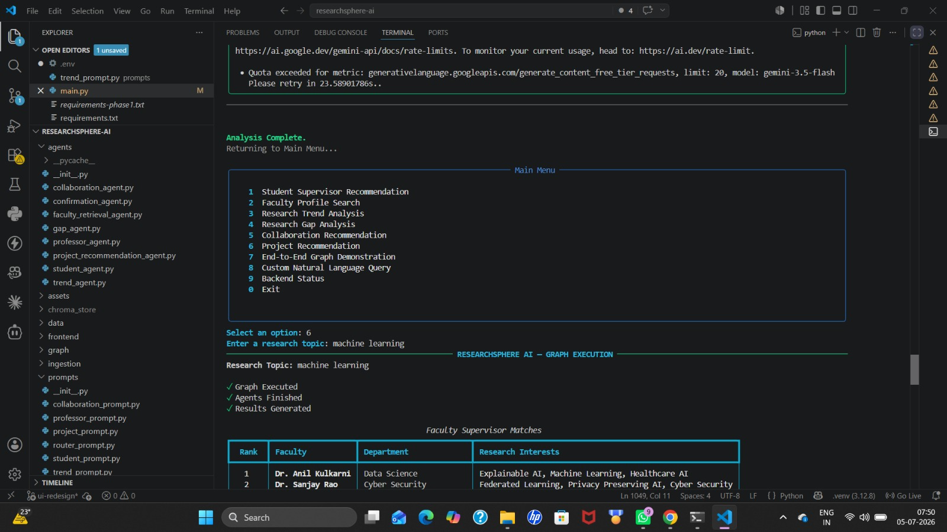

Slide 12
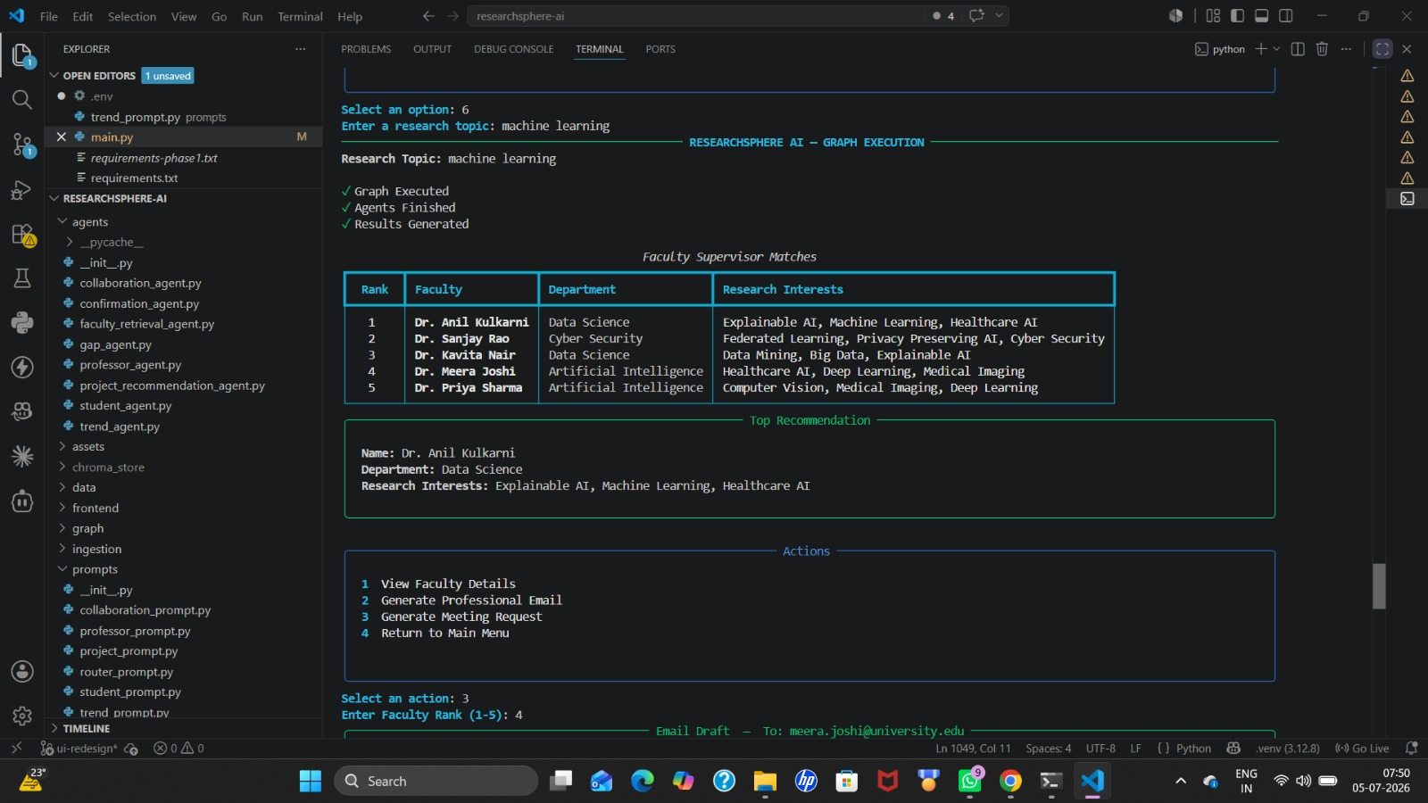

Slide 13
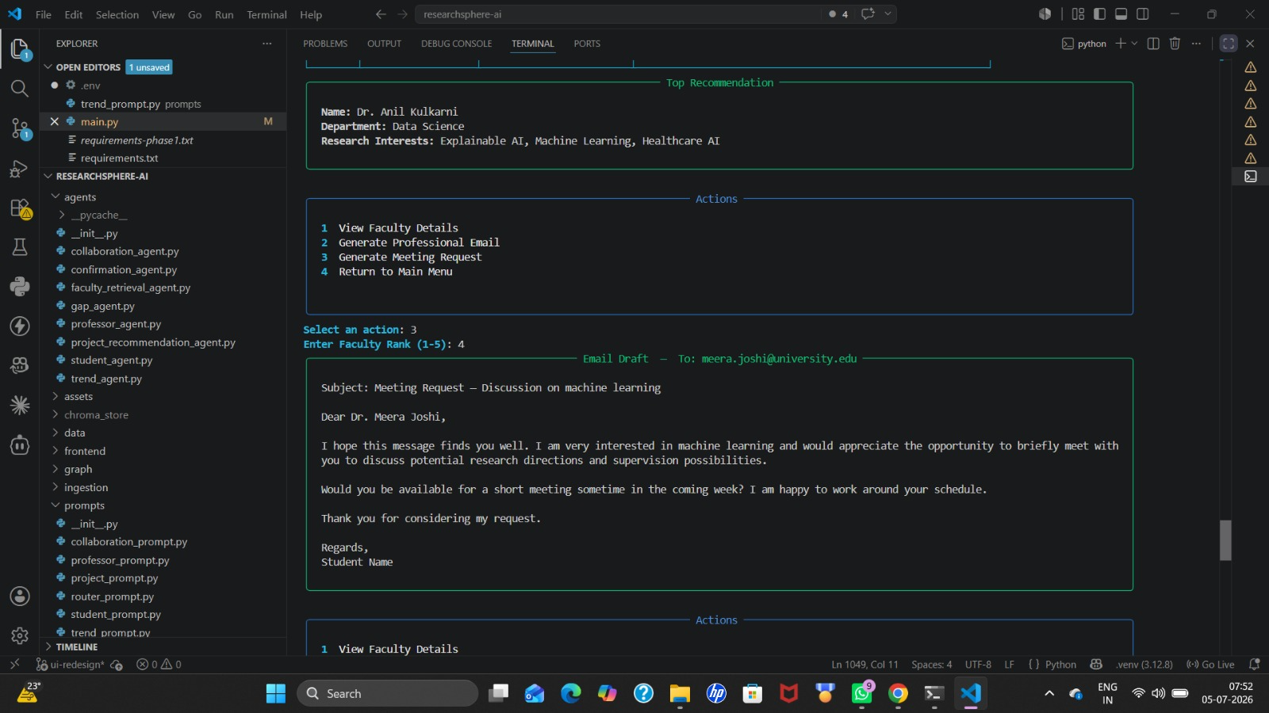

Slide 14
WHO BENEFITS
Project Impact
S
Students
P
Professors
U
Universities
Faster mentor and project discovery
Transparent faculty availability
Recommendations grounded in real data
Less manual trend-tracking
Data-driven collaborator suggestions
Visibility into research gaps
Better faculty capacity utilization
Stronger positioning in new fields
Auditable recommendation trail
Project Impact
11

Slide 15
ROADMAP
Future Scope
1
Faculty Comparison UI
5
Funding Recommendations
2
Student-Side Skill Gap Analysis
6
More Autonomous AI Research Assistant
3
Research Roadmaps
7
Resume Matching
4
Conference Recommendations
8
Knowledge Graph
Future Scope
12

Slide 16
Thank You
ResearchSphere AI — AI-Powered Research Matching Agent

